Slide 1
Intro to AI for Medicine
Lec 10: AI in the Clinic

Slide 2
Last Time
Explored infrastructure available which is used to create, accelerate and deploy AI
GPU vs CPU
AI Data Centers
Python packages like PyTorch, TensorFlow
Discovered ways to collaboratively train model weights
Federated Learning
Pretraining
Public Datasets

Slide 3
Today
How do we bring everything we know into the clinic and make strong decisions that benefit patients?
Practice thinking about ways existing AI interventions work
How do you build a team of experts to go from idea to working application?
What does the FDA approval process for medical devices look like?

Slide 4
Posing a question
Clinical question to answer
Technical problem statement
Regression vs classification
Supervised vs semi-supervised vs unsupervised
Other technical details
Loss function
Training regime
Network architecture
Implementation, coding and deployment
Notes:
Goal in this class is to get you from just 1 to 1 and 2, be aware of 3 and not really understand 4.

Slide 5
Tips to remember
Often many ways to approach a problem – many right answers
90% of the work is gathering the data
Something working poorly is better than nothing (just make it exist)

Slide 6
AI Menu
 | AI Tasks
Name | Regression | Classification | Multi-class
Definition | Predicting a number | Predicting which group of two | Predicting which group of many
Examples | Hosp Stay Duration | Stroke Detection | LLMs
Activation | ReLU | Sigmoid/Tanh | Softmax
Loss Fn | Mean squared error | Log loss | Multiclass log loss
 | Training Regimes
Type | Supervised | Self-Supervised | Unsupervised
Definition | We tell model what outputs should be | Block part of data and try to guess it | Choose hparams and let model find trends

Slide 7
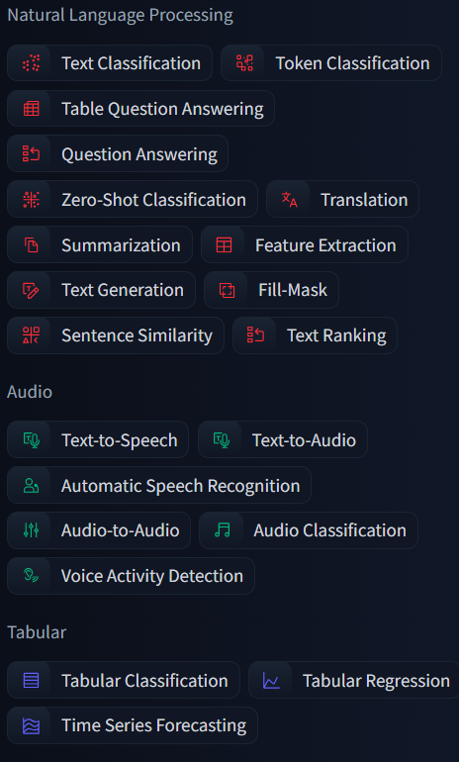
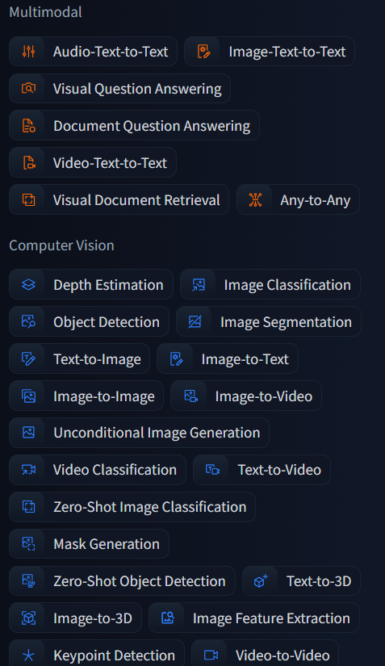
AI Menu
Special Data Types
Time Series | Imaging | Audio
Text | Video

Slide 8
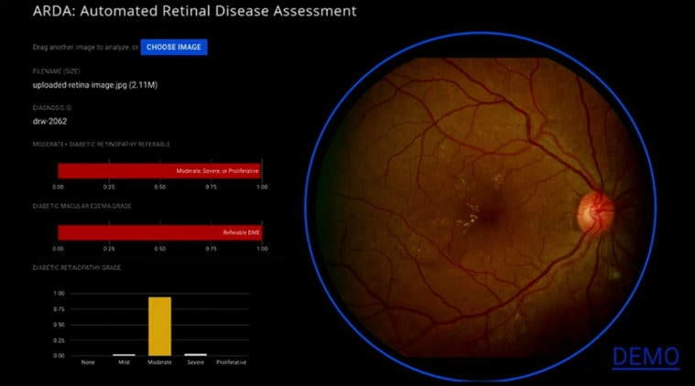
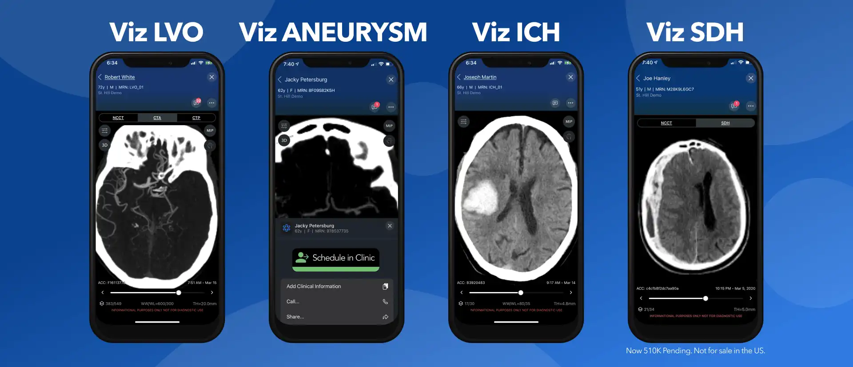
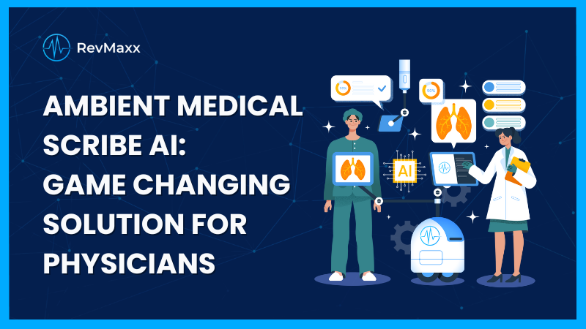
Medical AI On the Market
What have you guys heard of that’s out there?
Can we use what we know to make guesses as to how these work?
Notes:
Google retinal eye screen – supervised classification of image
Hemorrhage detection -> supervised classification of image
Ambient medical scribe -> supervised multiclass classification of audio where classes are text

Slide 9
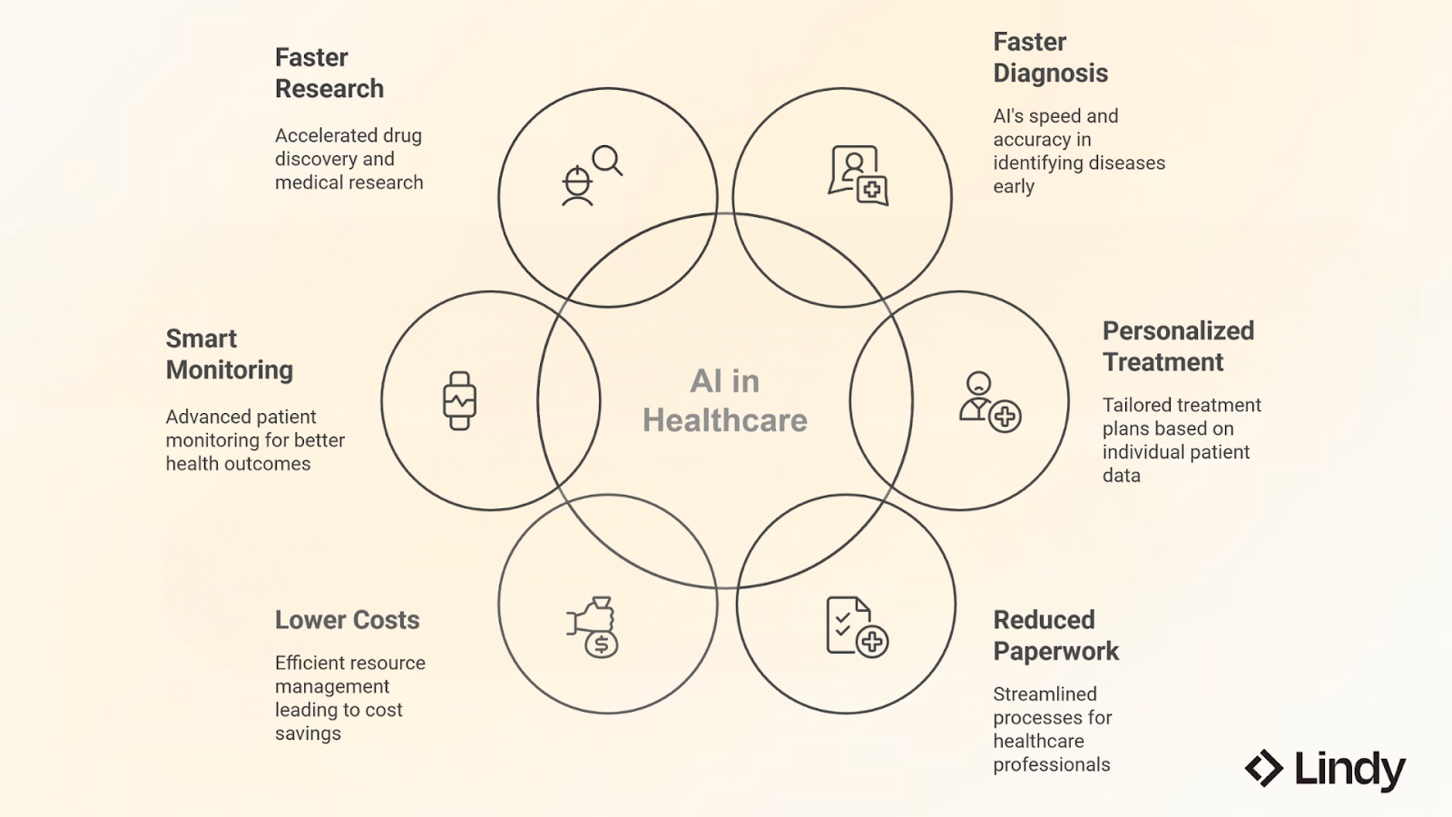
Areas to Consider

Slide 10
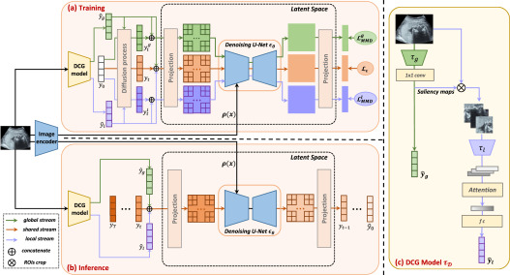
Building a team
As the clinician, your role is to pose a clinical question
Great investigators will keep the roles of other team members in mind
For example, an idea that has a certain novel network in mind is how you execute a cutting-edge idea and get engineers excited
Clinical pain point + feasible implementation = novel success

Slide 11
Building a team
Clinician: identify clinical pain point or question
Data engineer: source and clean data
Data scientist: perform analysis on data, including running models
Software engineer: build consistent applications that house models
Clinical Ethicist: Act as consultant regarding bias/safety of model

Slide 12
The Research to Deployment Timeline
Pose a relevant clinical question
Software/data team develops possible intervention
Intervention is compared to humans (or humans +-) compared (often RCT)
Assess for clinical safety, efficiency
Software team begins scaling and deployment
Post deployment monitoring

Slide 13
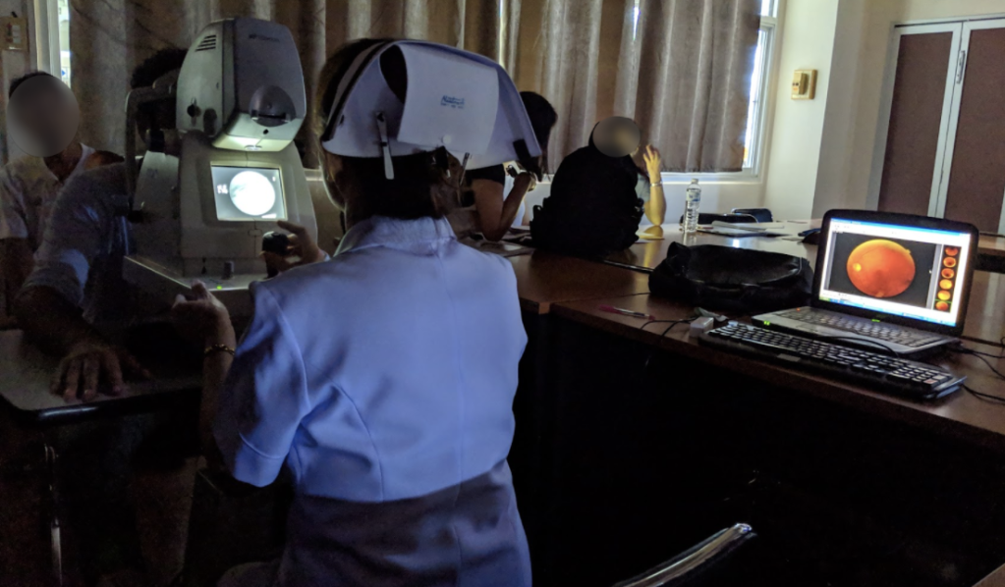
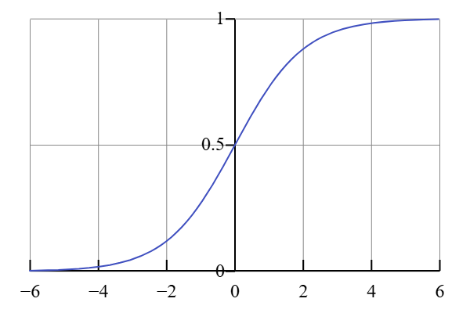
Challenges With Clinical Efficiency
Google’s Retinal AI
What were some challenges to implementation they faced?
Notes:
Cloud upload -> Patients had to wait
Had thresholds for positive and negative, in between was IDK
Nurses spent time fixing poor images to get a result, leading to delays

Slide 14
Overview of Clinical Data Ecosystems
Electronic Health Record (EHR) Systems
Picture Archiving and Communication Systems (PACS)
Surgical Robotics Integration

Slide 15
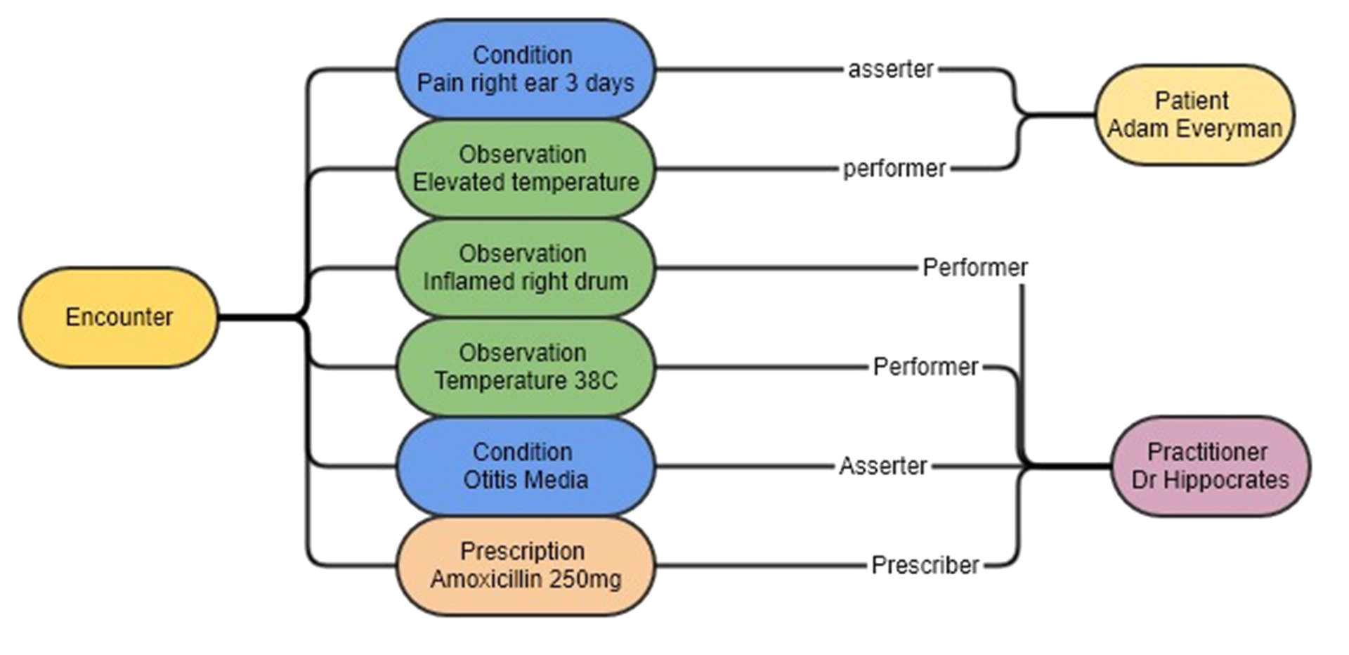
EHR Systems
Many on the market- they all have their own nuances
FHIR (Fast Healthcare Interoperability Resources)
Patient, observation, observer data structure

Slide 16
EHR Integration Points
Prediction
Documentation
Medical Coding
Operational Optimization (scheduling, billing)

Slide 17
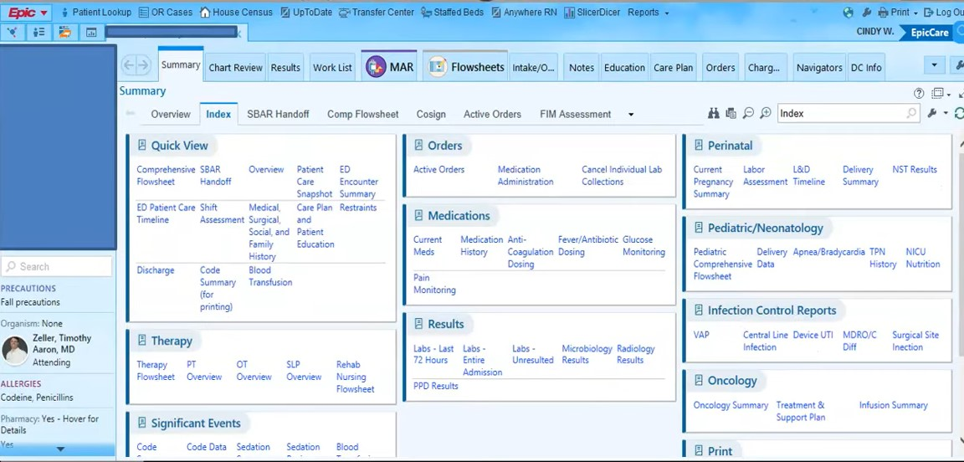
What are some clinical pain points for AI integration in the EHR? How might these be implemented?

Slide 18
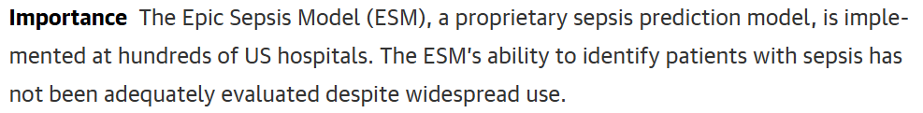
EPIC Sepsis Model
Model developed by EPIC and integrated into EHR system
Per EPIC:
Before: SIRS Criteria was flagged, but too many false +
Replaced with 60 factor model for assignment of risk score
Highlights contribution of features into score

Slide 19
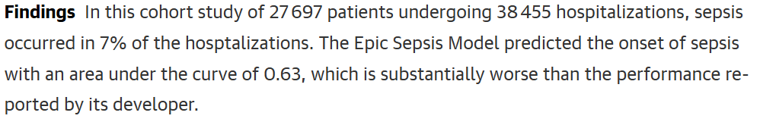
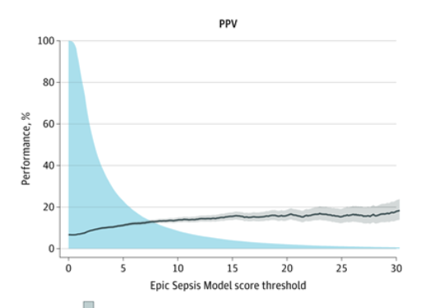
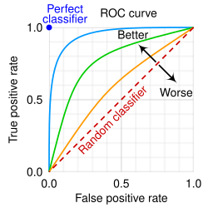
EPIC Sepsis Model
Which one corresponds to about AUROC = .63

Slide 20
General Problem Statement
Technical Problem Statement
Data | Loss
Network | Training
Notes:
Technical: Regression or temperature based classification of patients into sepsis protocol

Slide 21
EPIC Sepsis Takeaways
Poor PPV -> Alert fatigue, not solving problem it set out to
Proprietary models need scrutiny d/t conflict of interest
Let’s rate the following
Clinical motivation
Technical feasibility
Clinical utility
How would we improve this model? (or any model worse than clinicians)
Notes:
Good question to be asking clinically
Something that can easily be achieved by existing ML models
Something that can improve the way patients are treated

Slide 22
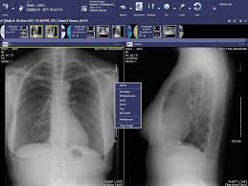
PACS
Picture Archiving and Communication Systems (PACS)
Database where Radiology images are stored
Interface for loading, viewing and reporting on Radiology studies
McKesson PACS

Slide 23
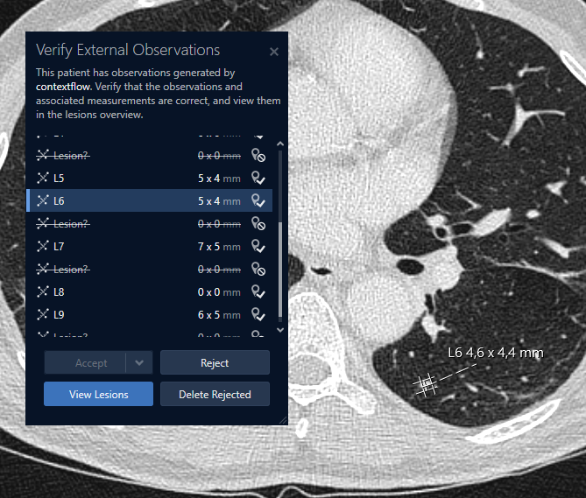
Integration Points
Prediction
Documentation
Medical Coding
Operational Optimization (scheduling, billing)

Slide 24
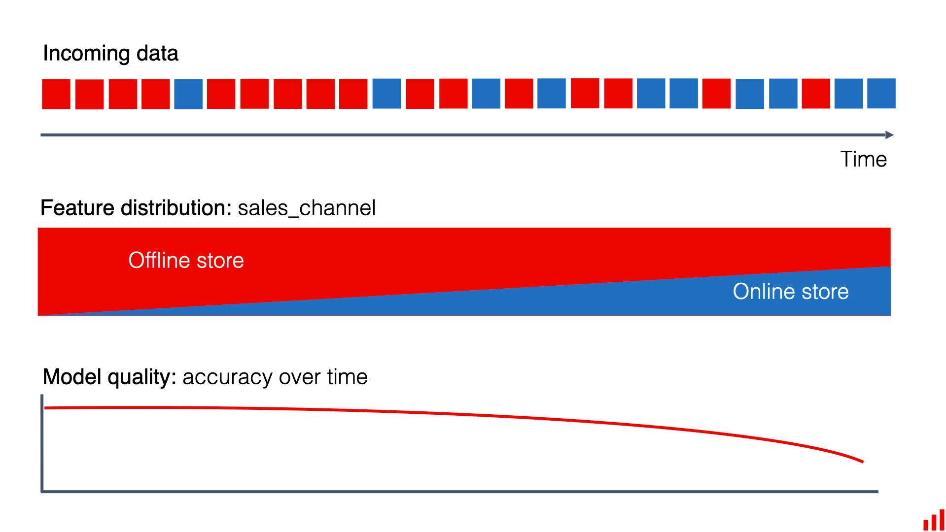
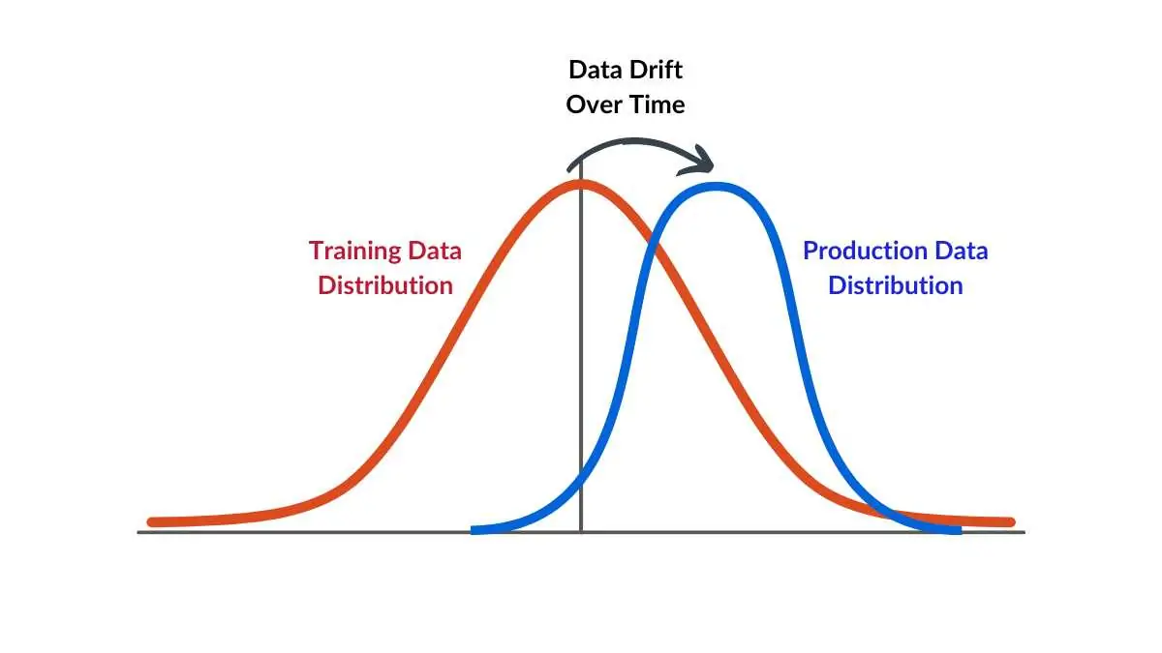
Data Drift
Gradual change over time between training dataset and real world population
Must consistently monitor algorithmic accuracy compared to ground truth
Notes:
Imagine a condition becomes more common, or starts to present in a different way
Ex. Covid made ARDS much more common in the general population

Slide 25
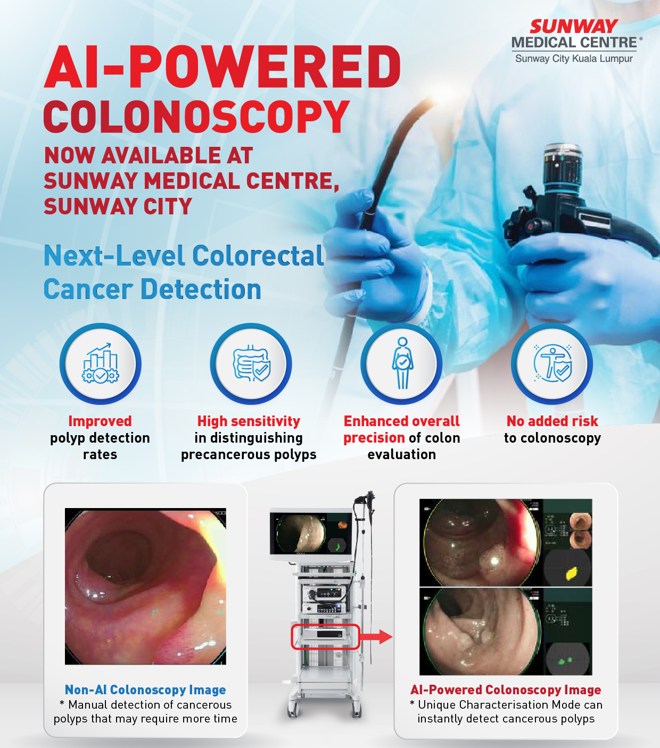
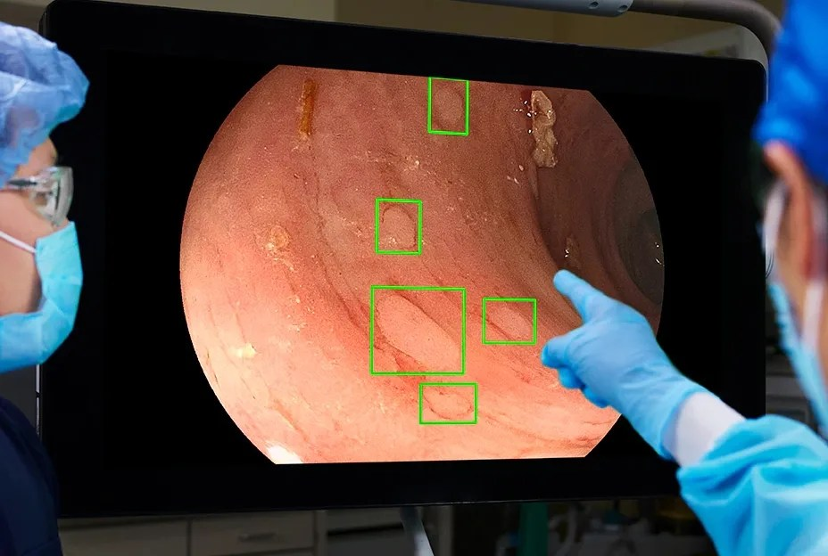
Procedures
Notes:
Where in the procedural or surgical workflow could AI intervene?
Is AI or regular algorithms better for surgery? Can the two be used in tandem?

Slide 26
Pathways for Medical Device Approval
510k
De Novo Approval
Premarket Approval
Exemptions (rare disease, breakthrough)
For the purposes of the FDA, software (including AI) is considered a medical device

Slide 27
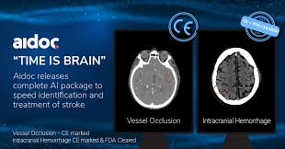
510(k) Pathway for Medical Devices
FDA approval process for medical devices
Must find a “predicate” device with same use
Notes:
If we made a new intracranial hemorrhage detection algorithm, we could cite Aidoc as a

Slide 28
Addressing Data Drift
Predetermined Change Control Plans (PCCPs)
Plan outlining what changes and surveillance will occur ahead of time
Not required for FDA approval

Slide 29
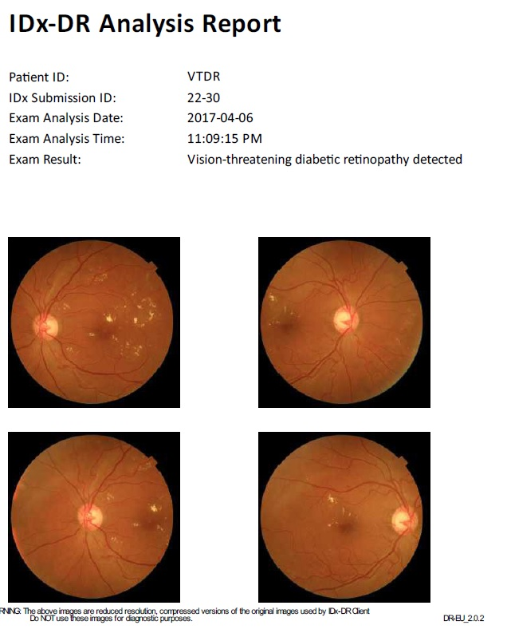
De Novo Device Approval
For devices that have no precedent
Ex. IDX: Diabetic retinopathy
Once approved, can serve as precedent in future 510k

Slide 30
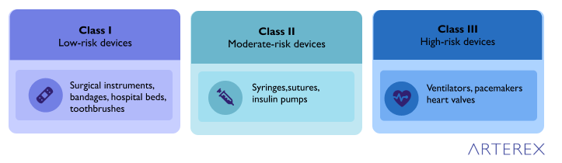
FDA Device Classification
Class I: Low risk (e.g., stethoscope) – usually exempt.
Class II: Moderate risk – majority of AI devices fall here.
Class III: High risk – life-supporting or life-sustaining, needs PMA.

Slide 31
FDA Device Classification
Class I: 510k eligible
Class II: 510k eligible
Class III: Needs pre-market approval

Slide 32
Pre Market Authorization
Needed for high risk medical devices
Design a study for use
During the study, obtain an investigational device exemption for the experimental device
Then, FDA reviews data for clinical approval

Slide 33
Next time:
Project Intro
Practice by coming up with a clinical question of your own

Slide 34
Thanks!

Slide 35
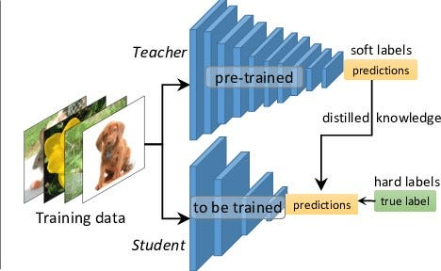
Knowledge Distillation
Used in cases where labelled data is scarce
Rare disease
Image segmentation

